Slide 1
Phonics

Slide 2
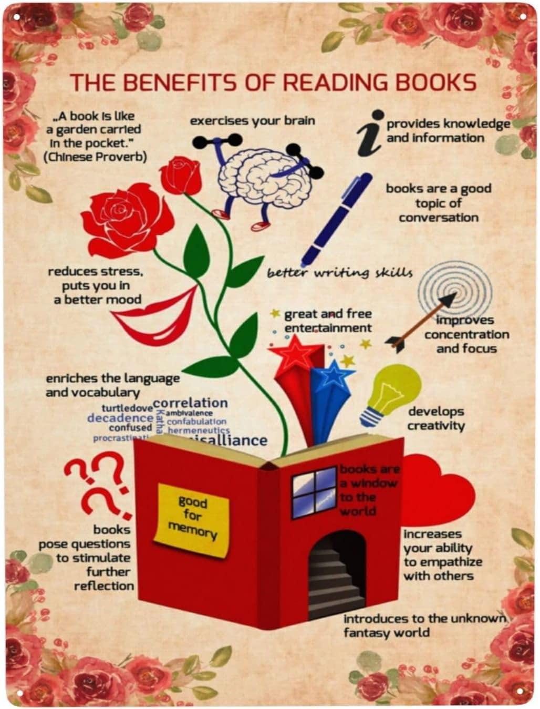
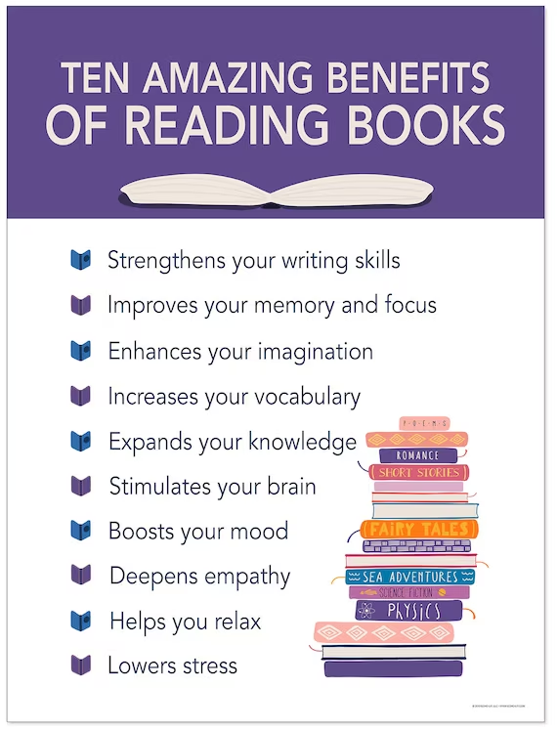
The importance of reading

Slide 3
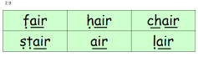

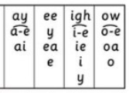
What is phonics?
begins in early years
recognising sounds to blend words
recognising common exception words
alternative sounds
constant clusters

Slide 4

RWI scheme
teaches children to decode words
important children produce pure sounds
progression of learning to blend words
Fred talk
green words
red words
multisyllabic words
word endings
plurals
fluency
comprehension

Slide 5
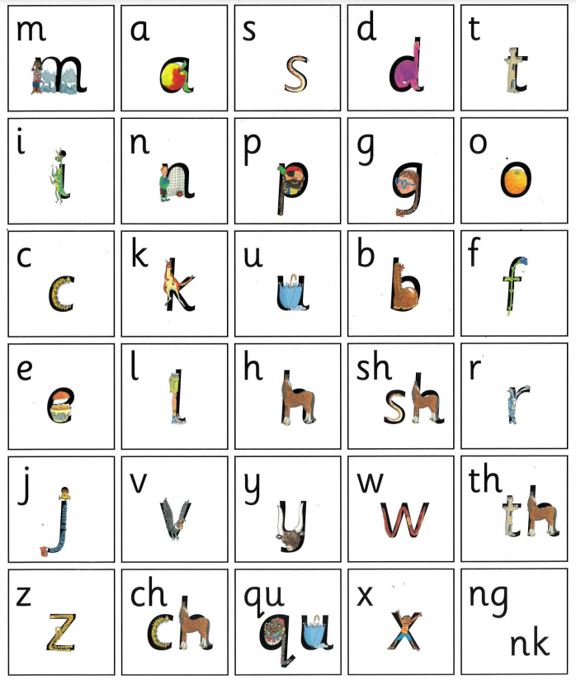
Set 1 sounds

Slide 6
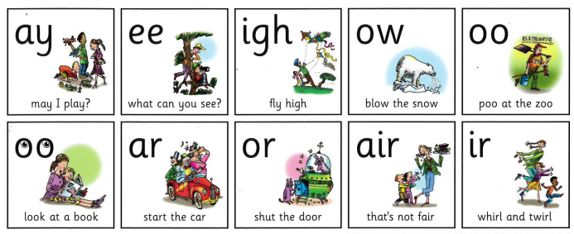

Set 2 sounds

Slide 7

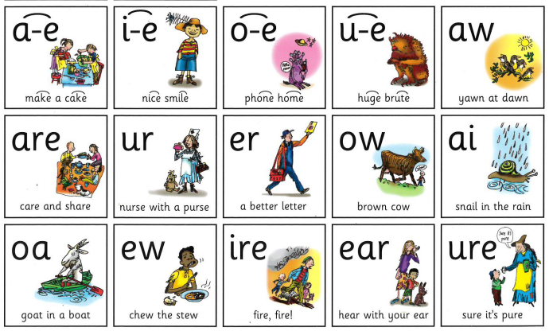
Set 3 sounds

Slide 8
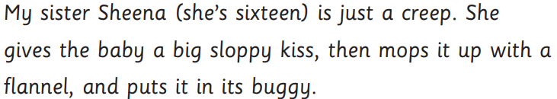
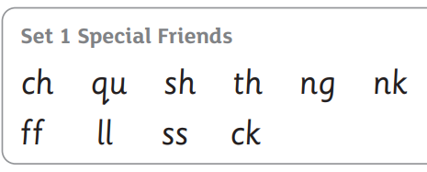
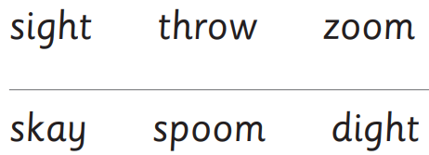
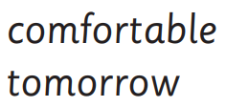
RWI assessment
Children assessed each half term
Assessment
  sounds they know in isolation
  reading sounds in words real and alien
  multisyllabic words and words with alternative sounds
  speed reading (60+ words a minute)

Slide 9
Phonic lesson
introduce new sound
practise new and previously taught sounds
Fred talk words with new sound in
read green words with new sound
speed read previously taught words
alien words with new sound
speed read previously taught alien words
practise writing sound
write words containing the sound
share the focus book

Slide 10

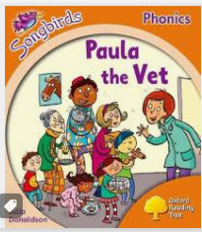
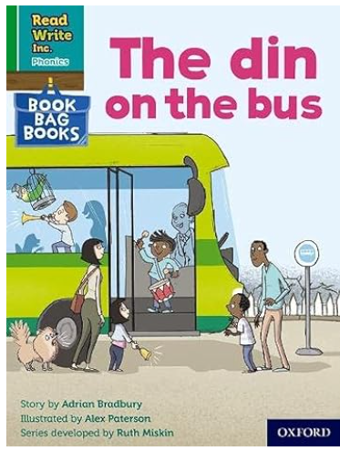

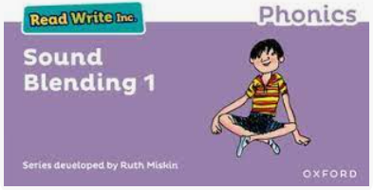
Reading books
Children begin by bringing a sound blending book home
booked linked to their sound knowledge – to practice special friends and red words
book from their phonic lesson – for fluency
when ready another reading book to build comprehension and red word knowledge.
library book for enjoyment.

Slide 11
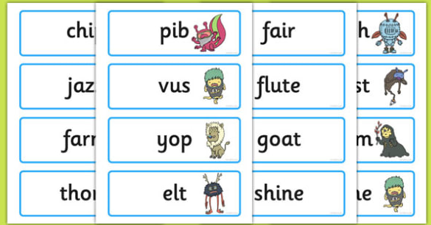
What is the phonics check?
children read 40 words
mixture of real and alien words
Sounds from all sets including alternatives included
Multisyllabic words
children will need to be able to read 32 correctly to pass
Once started they need to continue until they finish.
Summer term

Slide 12

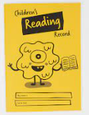
How can you support your child?
reading every day for at least 10 minutes - please record in reading log
support videos on school website
practising sounds
encouraging them to spot and read words around them
rhyming games
reading dogs - discuss stories being read
visit the library
encourage a love of reading
websites - class dojo, oxford owl, phonics play, ict games, top marks

